Slide 1

Welcome to H.O.T. www.handsontech.org
Our Purpose:
Forum for interaction
Many hobbyists build/tinker in isolation
Make new friends with common tech interests
Learn together
Lots of fun new tech to explore
Share expertise, help each other
Build something
Hands-On learning
Make something fun & useful

Slide 2





One Hands-On Tech club Two Groups
3D Printing
Small Computers

Slide 3
New to the club? Welcome!
Wondering what H.O.T. is all about?
This is a hands-on group, so we may be in the middle of a series of meetings on our way to building something interesting
Go to handsontech.org>New Members for a specially designed launching point for new members!
Please take the time to look through a few presentations at handsontech.org>Small Computers or handsontech.org>3D Printing.
Presentations are always available online after our meetings for reference and as self-paced projects

Slide 4
Club communications are via Email & Web !
To join our email list(s), fill membership form at handsontech.org>New Members
When asked for your email address, use a gmail email address if possible (we use google forums & they are picky)
You will be added automatically to our Hands-On Tech (H.O.T.) overall email list
You will also be added to the Small Computers and/or 3D Printing mailing lists and forums if you expressed interest in the membership form.
Meeting calendar is at handsontech.org

Slide 5
Remote Sensing
Solving Two Problems: Detection and Range
Feb 25, 2025 David Powell

Slide 6
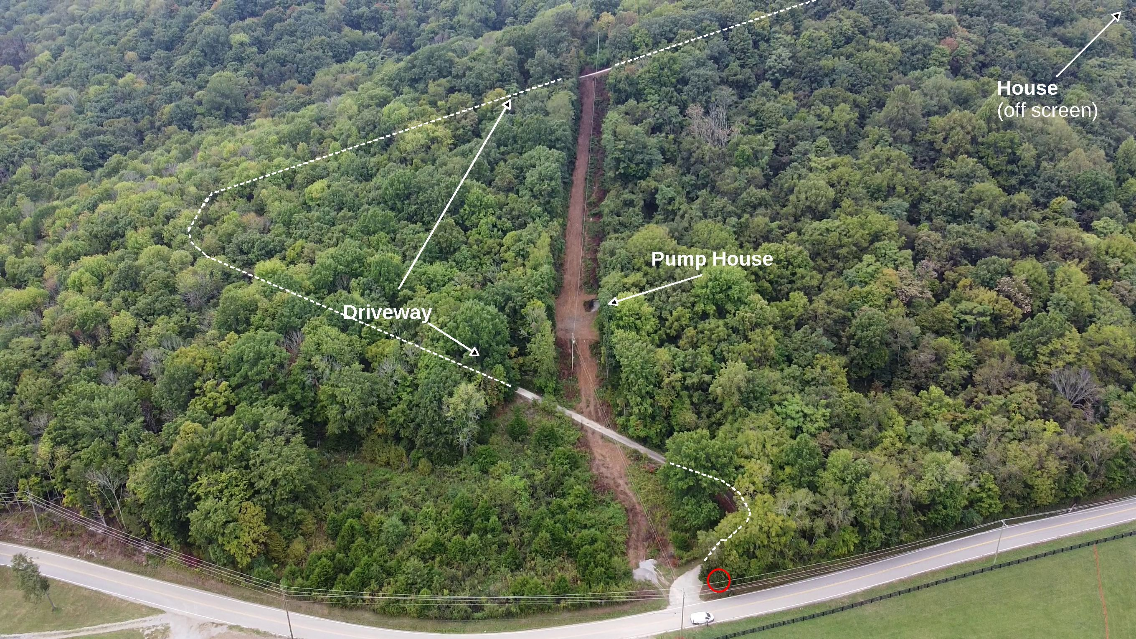
The Setup:
The street is at the bottom of the photo. The driveway comes off the street and winds back and forth up the side of the hill to the house (out of the picture at the top right). The brown line going up the hill is where we installed a new water line.

Slide 7
The Problems:
Delivery drivers don’t like coming up the driveway
I need a way to get packages delivered safely and securely
I need to know when a package is delivered, and if it is removed
It’s too far to run a wire or use WiFi. No cellular service either!

Slide 8
What I need is:
A delivery box where delivery drivers can put packages
A way to detect when a package is delivered or removed
A way to communicate that information to Home Assistant without cellular or wifi connectivity
A power source that doesn’t require any attention

Slide 9
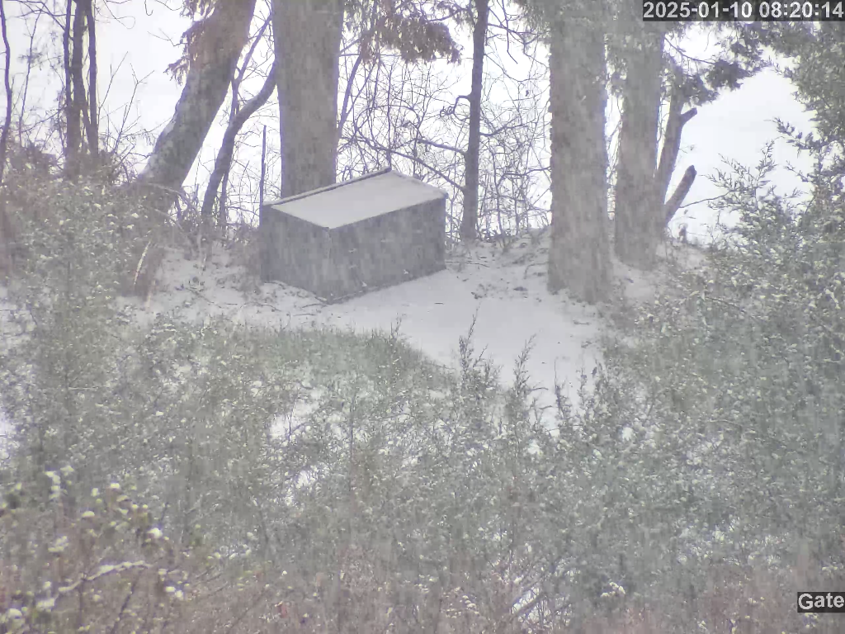
The Delivery Box
The delivery box hides behind some trees at the bottom of the driveway.

Slide 10
Sensing the presence of a package

Slide 11
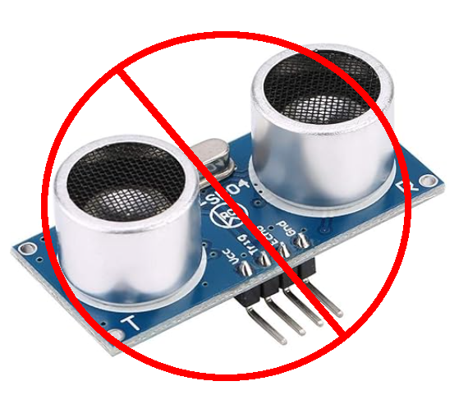
HC SR04 Ultrasonic Ranger
These didn’t work in my situation due to ribs in the box.

Slide 12
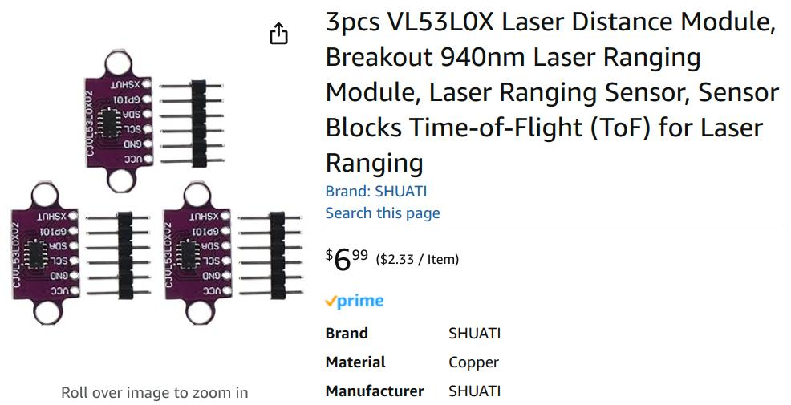
I Found These on Amazon

Slide 13
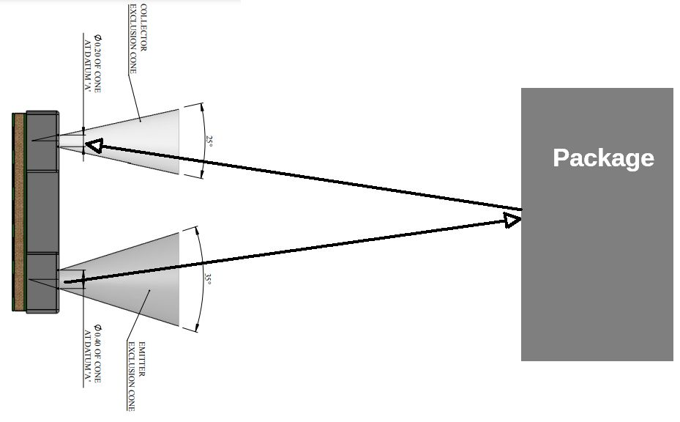
VL53L0X Operation

Slide 14
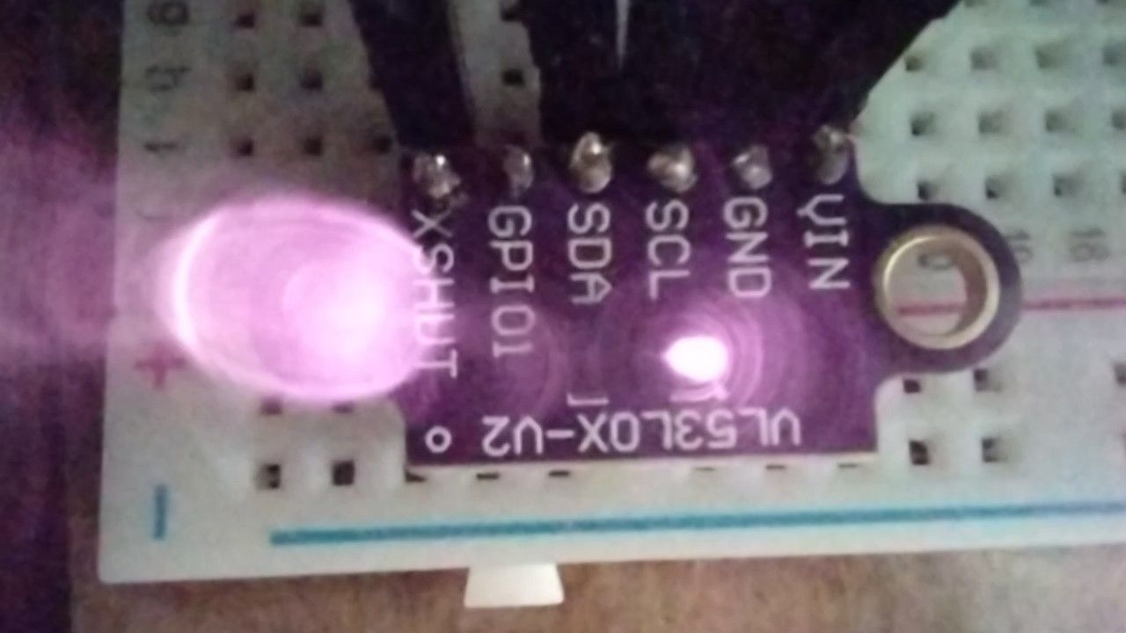
Laser is Infrared (940 nm)

Slide 15
Package was detected. How do I inform Home Assistant?

Slide 16
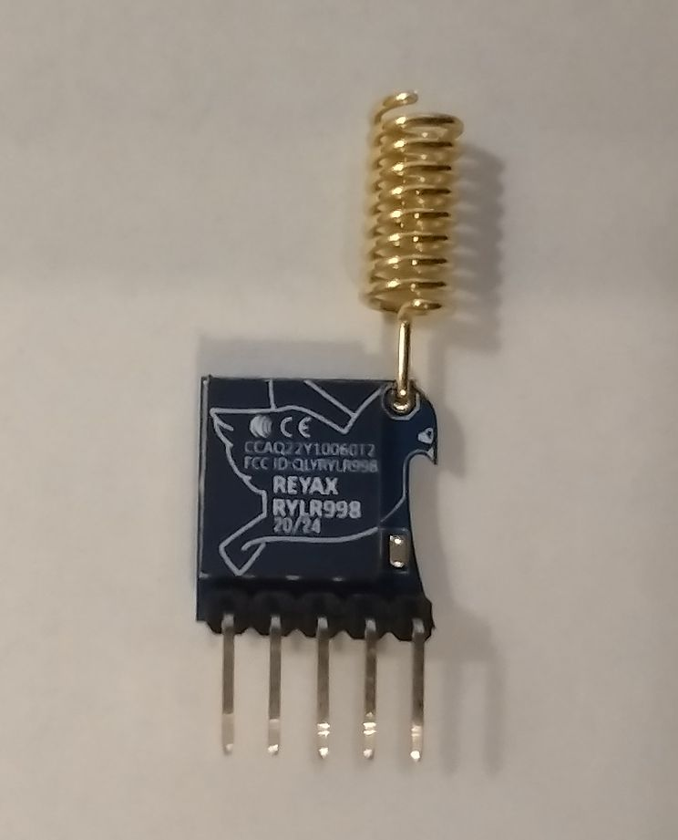
RYLR998 LoRa Transciever
FCC certified
Built-in antenna
Reports of reliable 1.5 km range
Simple AT command structure
Adjustable power, frequency, baud rate, spreading factor, bandwidth, address, network ID
Communications can be password protected
No message delivery confirmation!

Slide 17
Putting it all together

Slide 18
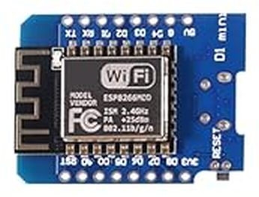
ESP D1 Mini (x2)

Slide 19
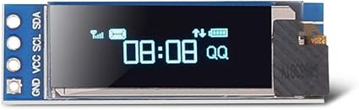
0.91” OLED Display (x2)

Slide 20
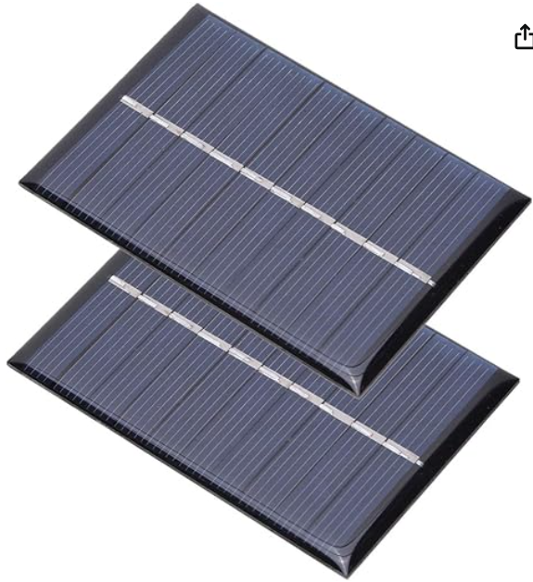

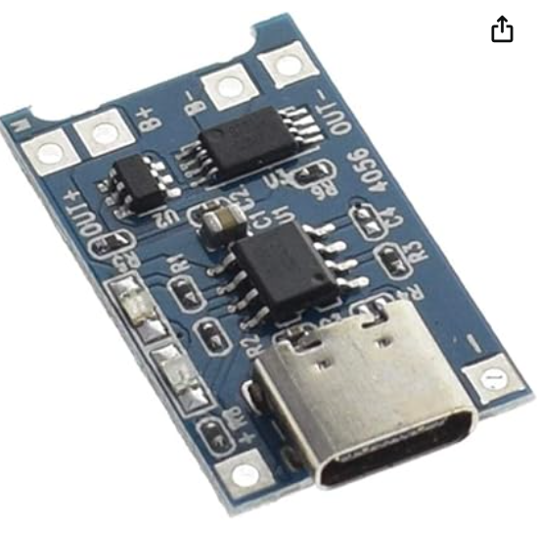
A Couple Of Solar Cells, a Battery, and a Charge Controller

Slide 21
Block Diagram
Pump House*
Fiber Optic Cable
WiFi Router
Receiver
Home
Assistant
LoRa
House
Delivery Box
* I’m not sure if the LoRa radio will reach all of the way to the house on the dinky built-in antennas. Fortunately, it only has to get to the pump house.
Sensor/Transmitter
Package

Slide 22
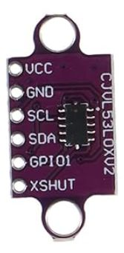
Laser Ranging Module
VCC – 2.6v to 5.5v
GND – Ground
SCL – IIC Clock
SDA – IIC Data
GPIO1 – A general purpose mystery output
XSHUT – Drive this low to hold the device reset (low power)

Slide 23
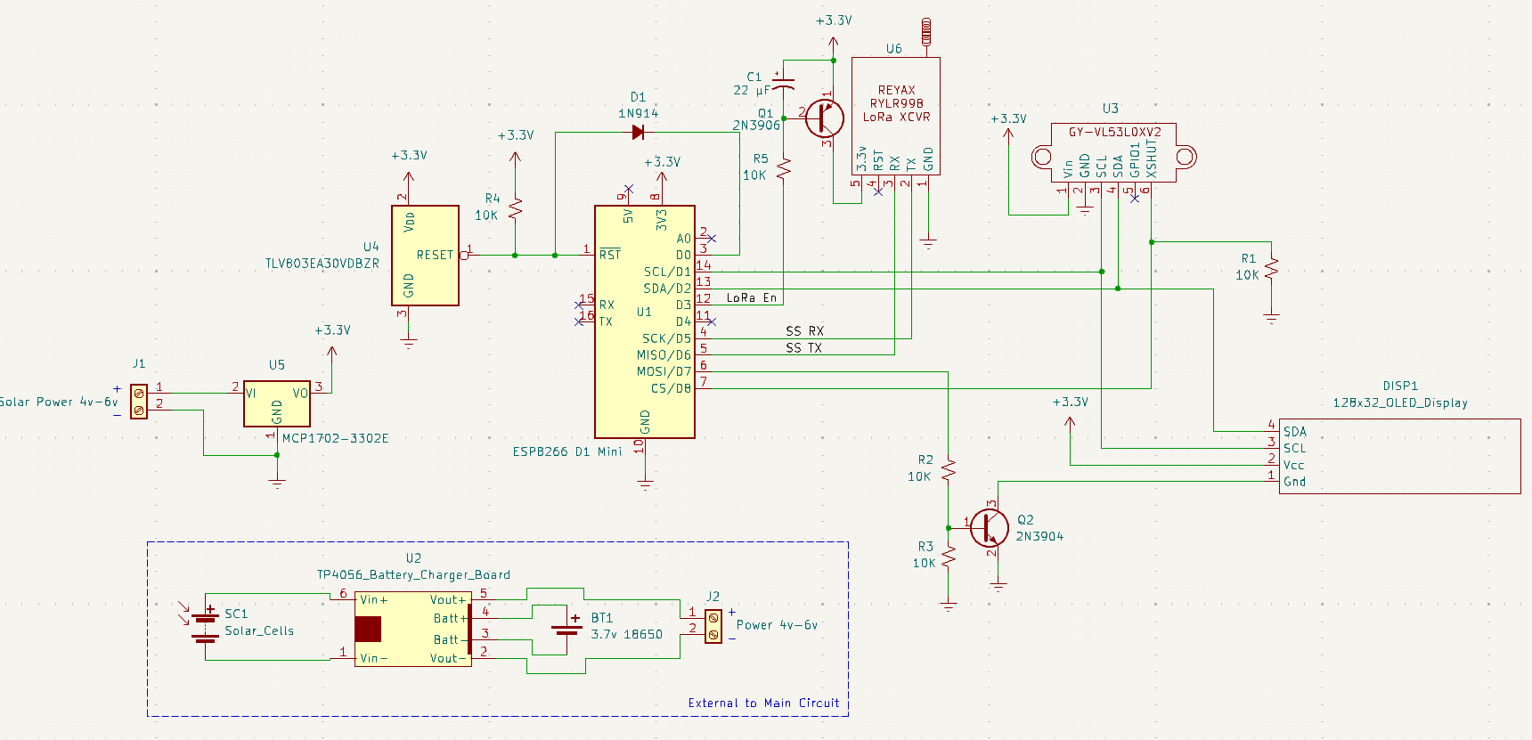
Schematic - Sensor/Transmitter

Slide 24
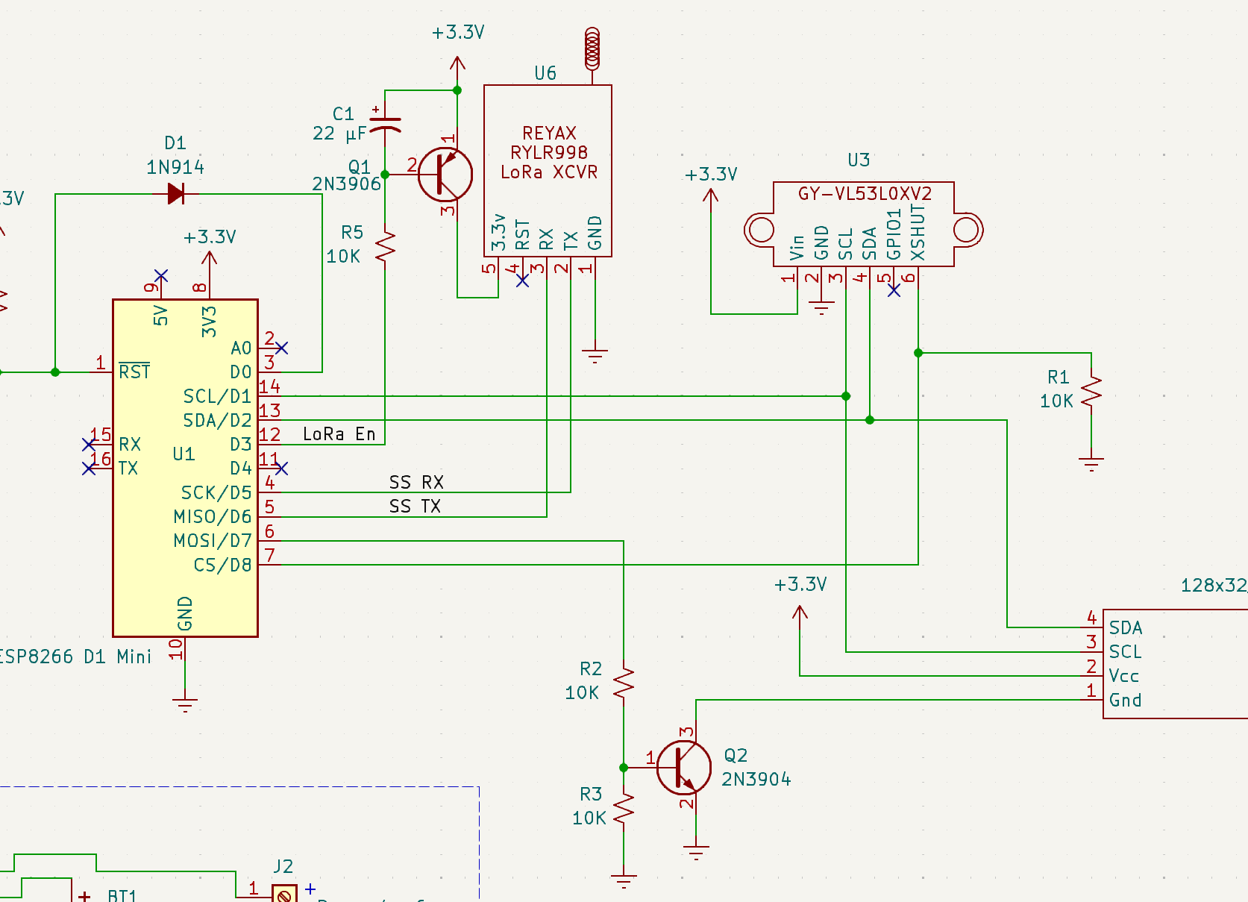
Sensor Circuit

Slide 25
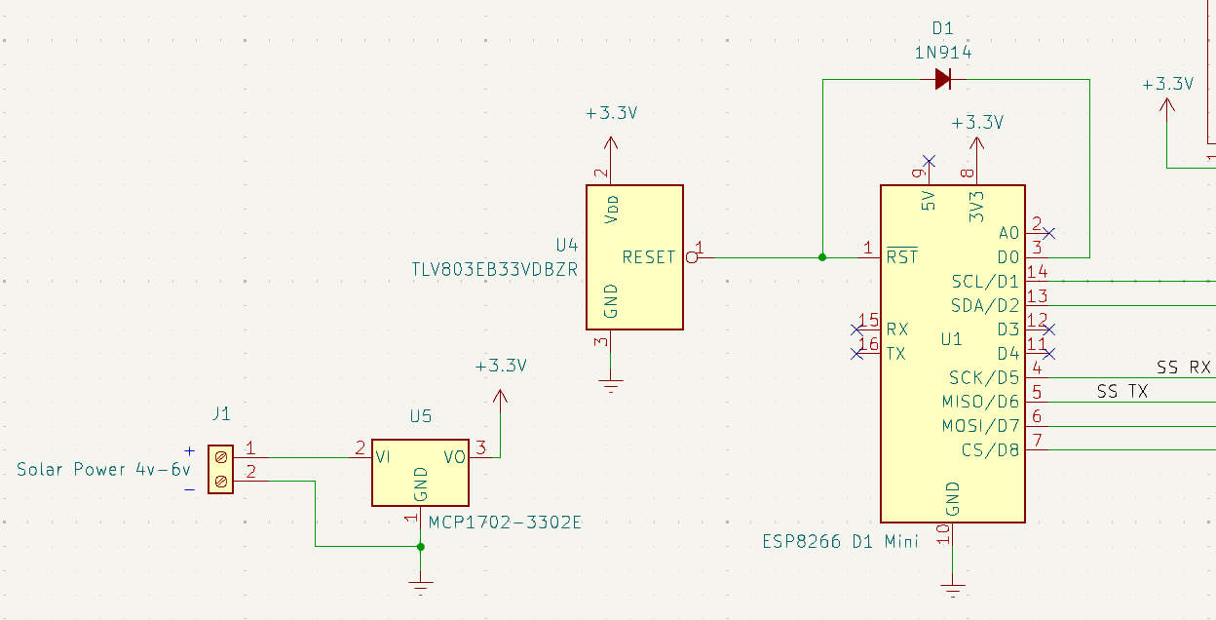
Sensor Circuit

Slide 26
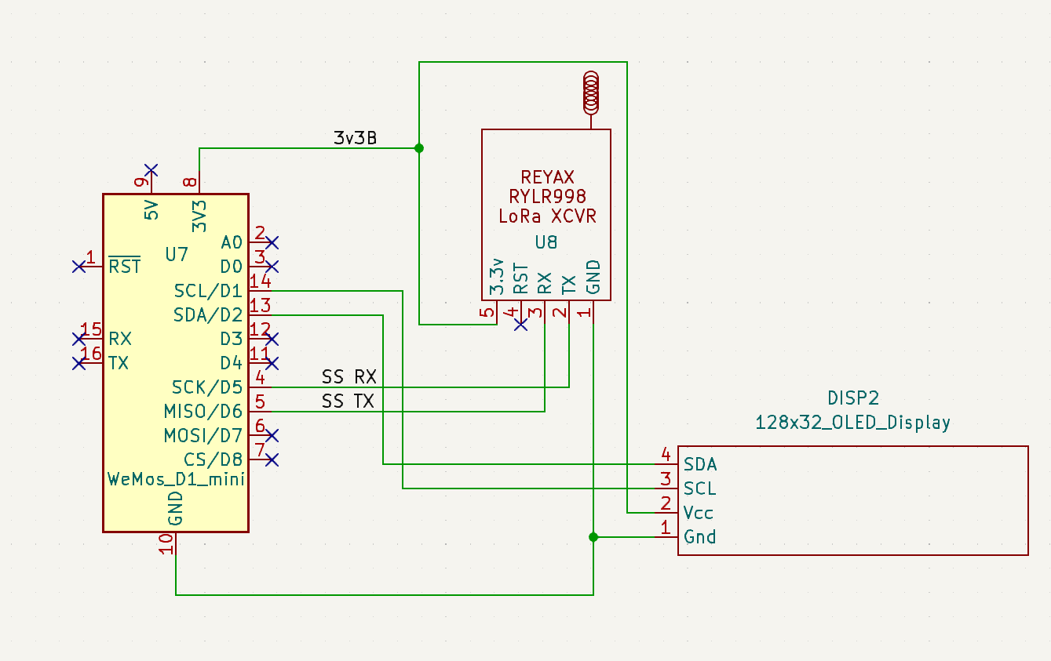
Schematic - Receiver

Slide 27
Software - Sensor/Transmitter
Sleeps most of the time; wakes every X minutes to check for a package (X is TBD)
All parameters are configurable via the USB serial port
Display can be disabled to save even more power
Each measurement is an average of 5 readings
Only reports after two consecutive measurements that indicate a change of status, or an hour has passed
A range of measurements can be set for package presence. If measurement is within the range then a package is present.
Reports with a JSON object via LoRa to the receiver

Slide 28
Software - Receiver
Does not sleep since it is USB powered.
Listens for incoming JSON-encoded LoRa messages.
Parses the message and sends an MQTT topic for each element.
Configuration can be done via USB or MQTT commands.
MQTT communication is done via WiFi.

Slide 29
Hardware Sources
3 pcs VL53L0X Laser Distance Module ($6.99) https://www.amazon.com/dp/B0CQ28Q3KC
RYLR998 868/915 MHz Lora Module ($12.60) https://www.amazon.com/dp/B099RM1XMG
5 pcs ESP8266 Mini D1 Module ($13.99) https://www.amazon.com/gp/product/B081PX9YFV
2 PCS 0.91'' IIC OLED Display Module ($5.99) https://www.amazon.com/gp/product/B07FMDB6TR/
3pcs TP4056 18650 Lithium Battery Charger ($5.99) https://www.amazon.com/dp/B07PKND8KG

Slide 30
Other Resources
Reyax RYLR998 AT Command User Guide: https://manuals.plus/reyax-technology/rylr998-lora-at-command-guide-manual
VL53L0X Time-Of-Flight Ranging Sensor https://www.st.com/resource/en/datasheet/vl53l0x.pdf
SSD1306 OLED Display Driver Data Sheet https://cdn-shop.adafruit.com/datasheets/SSD1306.pdf
TP4056 Lithium Ion Battery Management Board https://dlnmh9ip6v2uc.cloudfront.net/datasheets/Prototyping/TP4056.pdf
Complete Project Including STLs, Board Designs, and Code https://github.com/buteomont/Delivery-Box-Reporter-LoRa

Slide 31
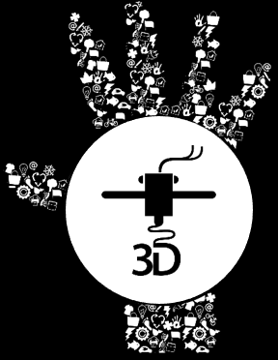




These graphics are PNG files and cannot be ungrouped. Use these when using LibreOffice or other
non MS PowerPoint programs. They will not “fragment”.

